Slide 1
Telecom-customer churn prediction
Aryan kulkarni

Slide 2
Step-1 import required libraries
Numpy- For numerical operations
Pandas- For handling and manipulation of datasets
Matplotlib- For data visualization
Seaborn – It is also a visualization library like matplotlib where more interactive and statistical models are made using this library.
Sklearn (Sci-Kit learn) – It is a Machine Learning framework from where we will import specific algorithms.

Slide 3
Step-2 loading and cleaning the dataset
Then after importing libraries load the dataset.
Find the null/missing values in the dataset. Fill the missing values with mean, median, mode according to the nature of features.
Encoded the categorical values to numerical values through grade mapping.
Remove unnecessary columns that are not required for prediction.

Slide 4
Step-3 Data Visualization
Then visualize the data to check the nature of each feature.
Check where normalization of data is needed.
Then draw a box plot to check whether there are any outliers in the dataset.

Slide 5
Step-5 model building
Then build the models of Logistic Regression, Decision Tree & Random Forest Classifier.
Then do K-fold cross validation.
Then evaluate the models if overfitted or underfitted to get the accurate results.

Slide 6
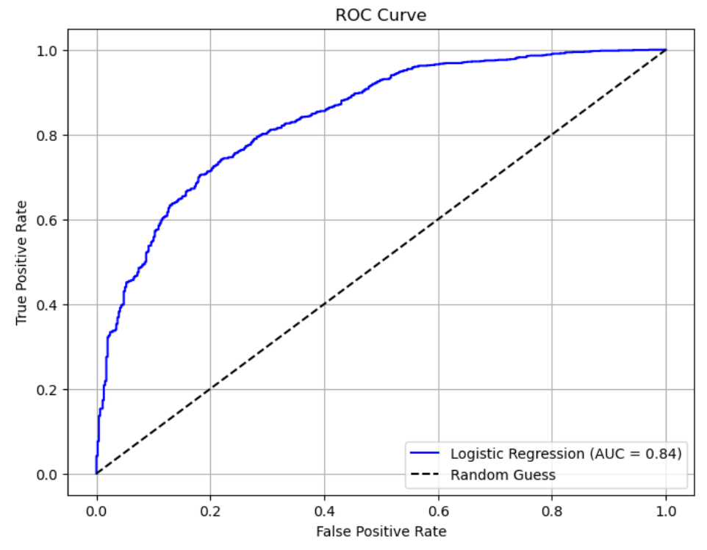
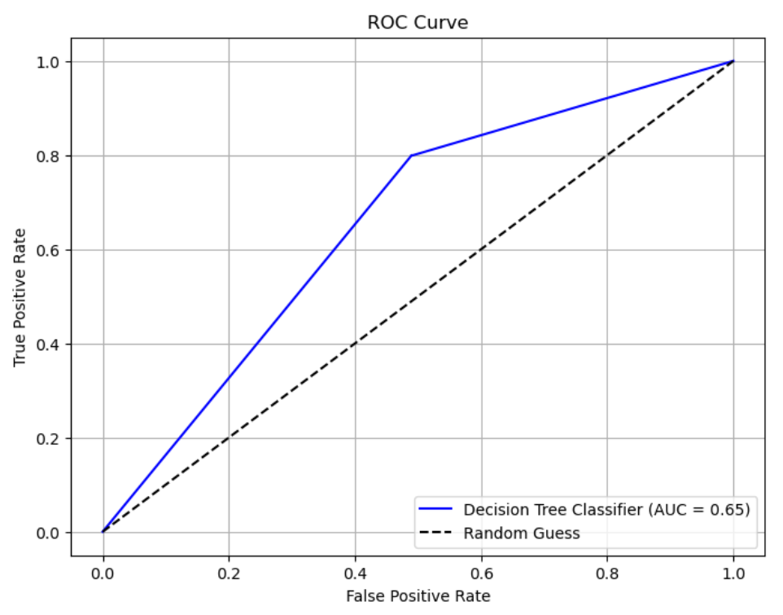
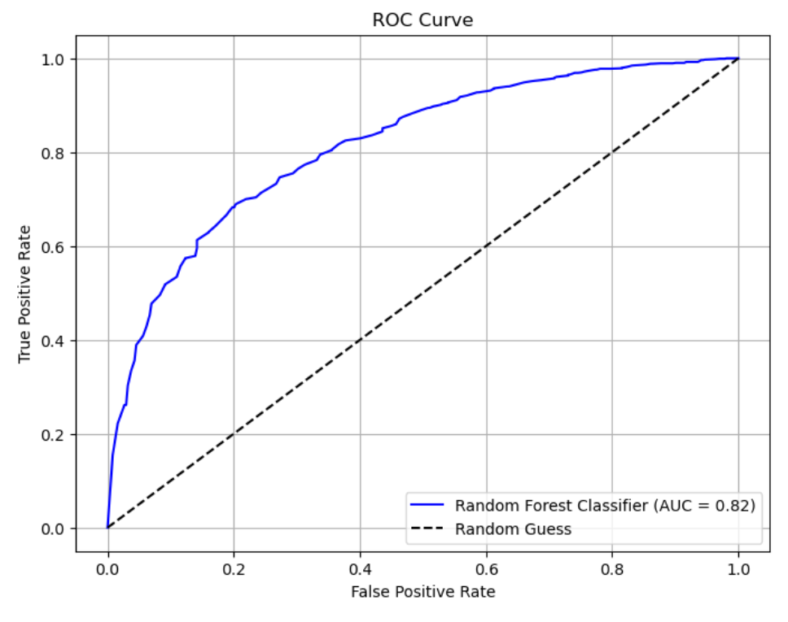

Slide 7
Model deployment on Render
Random forest is the best fit model in this project.
So saved the training model in pickle file.
Then in VS code created a Virtual Environment where I can test and run my application.
As it was a web application I wrote HTML code for it and linked it with app.py file where we used flask for deploying web application.

Slide 8
Model summary
Logistic Regression – Evaluation Score = 79%, AUC-Score = 0.84
Decision Tree Classifier – Evaluation Score = 78%, AUC-Score = 0.65
Random Forest Classifier – Evaluation Score = 80.24%, AUC-Score = 0.82
Hence the Random Forest Classifier Model is best fit.
Then save the Training model of evaluation in a pickle file.

